Slide 1


Degree Flow
A Personalized Degree Planning System
Proof of Concept submission:
Project Goal: A degree planning platform that provides personalized course recommendations, real-time notifications, and interactive pathways to simplify academic progress for McMaster students.
Team 04 Members:
Harshit Sharma
Anderson Zhou
Aniruddh Arora
Anupam Raj
Sarah Neelands
Yanchun Wang

Slide 2
The Problem Statement
Introduction: Currently, students at McMaster University face significant challenges in planning their academic pathways due to lack of integrated and user-friendly tools.
Key Challenges:
Students need to rely on manual tools such like Excel for organization that are time consuming and inefficient.
Students use Mosaic to check for course availability and schedules, but the current system lacks Personalized guidance and real-time alerts/notifications about course updates.
Students must go through "what-if" scenarios manually for changing majors/minors, but there’s no tool to calculate how it impact their graduation timeline and courses they can choose.
Students need to manually Track Pre-requisites for future courses before enrolling in courses which highly error prone and there’s no system to flag unmet requirements for courses they may want to take.
Students currently miss seat availability due to lack of real-time seat availability alerts.

Slide 3
Key Features
Course Search: Enables quick filtering of courses by availability and requirements.
Degree Progress Tracking: Displays completed, in-progress and required courses for current academic pathway.
Personalized Course Recommendations: Suggests courses based on Transcript and degree requirements.
Read-Time notifications: Alerts for seat availability and schedule changes
What-if Scenarios: Allows exploring alternate academic pathways.
Automatic Schedule generation: Generates conflict free schedules based on preferences
Transcript parsing: Extracts all relevant information from unofficial transcript
Course ratings and Feedback: Allows users to rate and provide feedback for the courses they have completed.
User personalization: Users can set their favorite courses or departments.

Slide 4
Stakeholders
Students: The primary users who benefit from improved degree planning.
Academic Advisors: Advisors may use the system for better guidance and decision-making.
University Administrators: Gain insights into student needs for resource allocation.

Slide 5
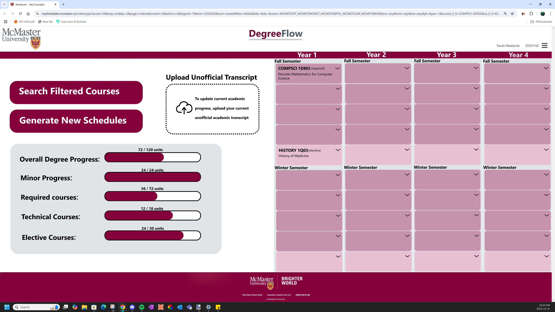
Degree Overview Page
Tracks overall progress for student by providing a visual representation of the student’s progress towards degree Completion. Completed, In-progress and required courses are displayed in the schedule.

Slide 6
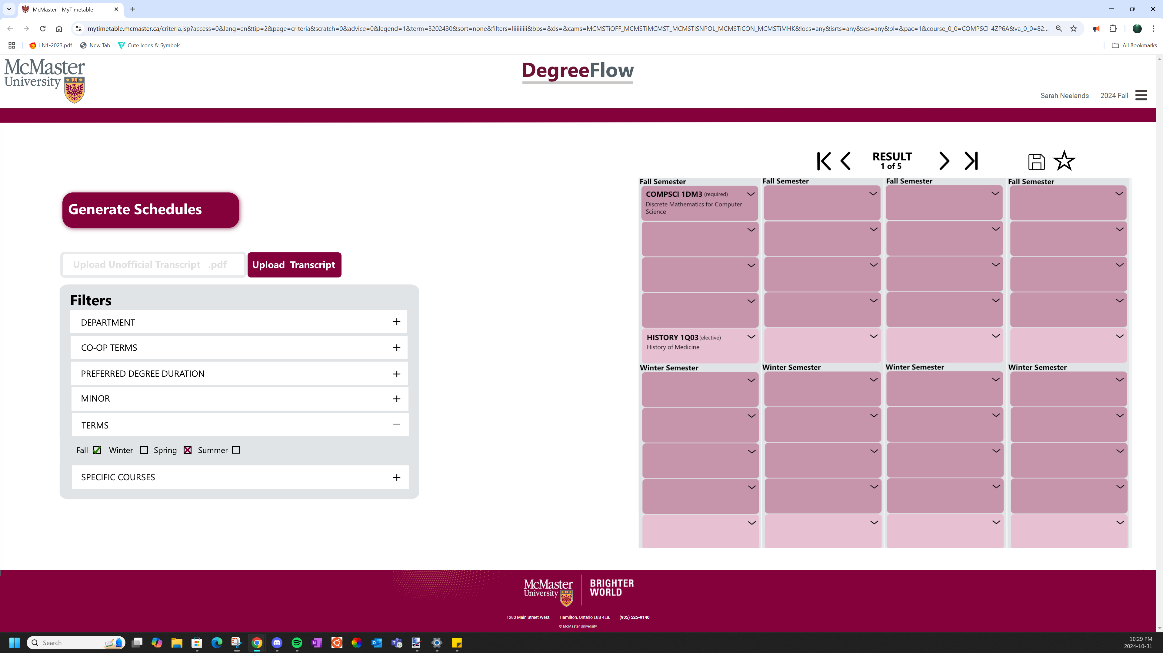
Course Scheduling Page
Allows students to plan and generate optimized course schedules automatically, avoiding conflicts and adhering to prerequisites

